Slide 1


FOCUS FOR THE YEAR
BECOMING A GROWING FAMILY…
… BY GOING DEEPER

Slide 2
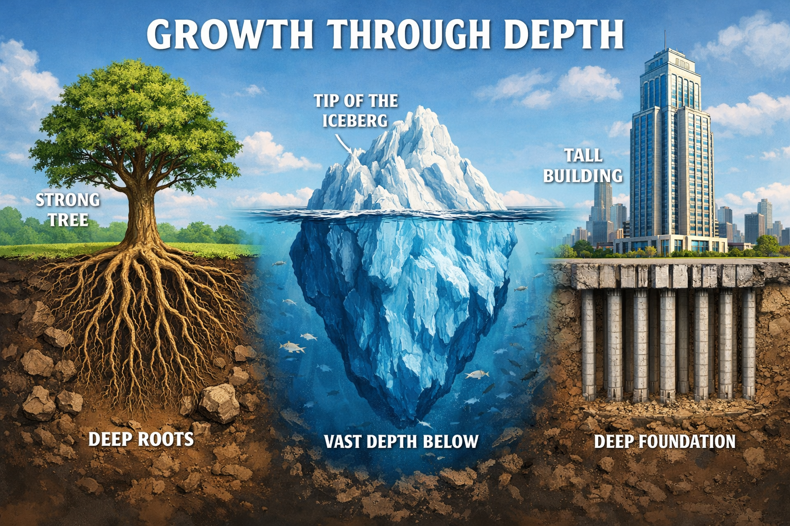

Slide 3
FOCUS FOR THE YEAR
BECOMING A GROWING FAMILY…
… BY GOING DEEPER
Deeper into God’s word
Deeper into each other’s lives

Slide 4
FOCUS FOR THE YEAR
BECOMING A GROWING FAMILY…
… BY GOING DEEPER
Deeper into God’s word
Deeper into each other’s lives

Slide 5
So in Christ, we though many form one body, and each member belongs to all the others.
Romans 12:5

Slide 6
So in Christ, we though many form one body, and each member belongs to all the others.
Romans 12:5
Why becoming a growing family can feel impossible

Slide 7
So in Christ, we though many form one body, and each member belongs to all the others.
Romans 12:5
Why becoming a growing family can feel impossible

Slide 8
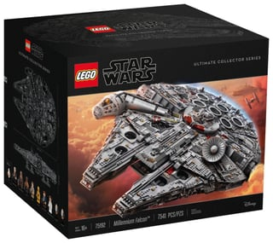
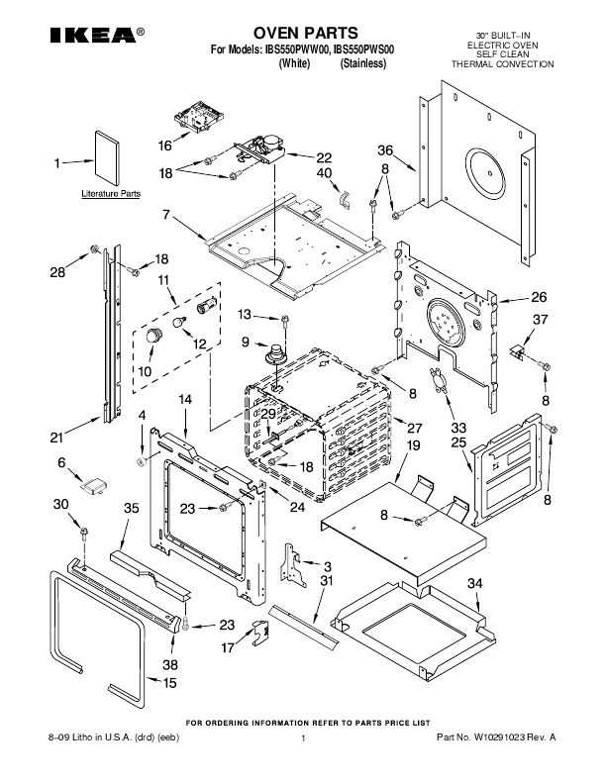
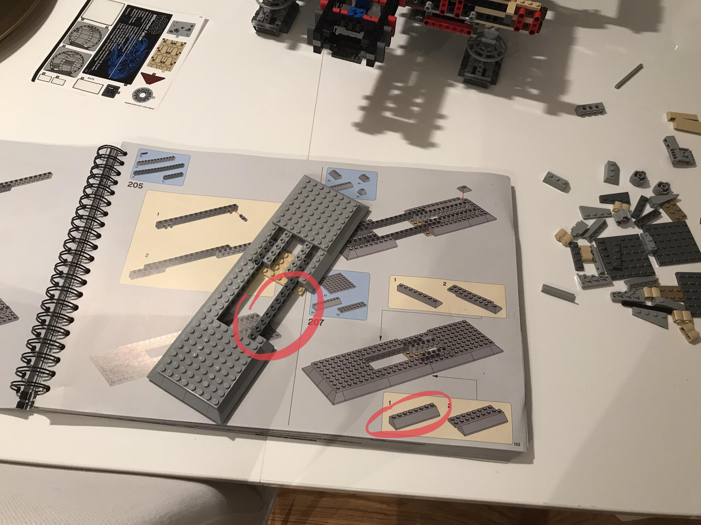
We though many…form one body

Slide 9


We though many…form one body

Slide 10

We though many…form one body

Slide 11
What might we do when church feels difficult?

Slide 12

What might we do when church feels difficult?
1st Strategy: Turn church into a drive-through

Slide 13

What might we do when church feels difficult?
1st Strategy: Turn church into a drive-through
2nd Strategy: Find a mini body within the body

Slide 14
So in Christ, we though many form one body, and each member belongs to all the others.
Romans 12:5
Why becoming a growing family can feel impossible

Slide 15
What might we do when church feels difficult?
Each member belongs...
1st Strategy: Turn church into a drive-through
2nd Strategy: Find a mini body within the body

Slide 16
What might we do when church feels difficult?
Each member belongs... …to all the others
1st Strategy: Turn church into a drive-through
2nd Strategy: Find a mini body within the body

Slide 17
So in Christ, we though many form one body, and each member belongs to all the others.
Romans 12:5
Why becoming a growing family can feel impossible

Slide 18
So in Christ, we though many form one body, and each member belongs to all the others.
Romans 12:5
Why becoming a growing family is possible

Slide 19
So in Christ, we though many form one body, and each member belongs to all the others.
Romans 12:5
Why becoming a growing family is possible

Slide 20

IN CHRIST

Slide 21
What do we have in Christ?

Slide 22
What do we have in Christ?
FORGIVENESS

Slide 23
What do we have in Christ?
FORGIVENESS
ACCEPTANCE

Slide 24
What do we have in Christ?
FORGIVENESS
ACCEPTANCE
MISSION

Slide 25
What do we have in Christ?
FORGIVENESS
ACCEPTANCE
MISSION
IDENTITY

Slide 26
What do we have in Christ?
FORGIVENESS
ACCEPTANCE
MISSION
IDENTITY
LOVE

Slide 27
What do we have in Christ?
FORGIVENESS
ACCEPTANCE
MISSION
IDENTITY
LOVE
YOU

Slide 28
So in Christ, we though many form one body, and each member belongs to all the others.
Romans 12:5
Becoming a growing family in 2026 might sometimes feel impossible, but it is possible!

